Slide 1

School of Computer Science and Engineering
Department of Computer Science and Engineering
AI-Based Market Trend Analyzer
Submitted By: Divyansh Tuteja
2427030228
Supervised By: Dr. Mohit Kushwaha

Slide 2
Introduction
Financial markets react instantly to world events such as political decisions or economic announcements.
These changes influence commodities like gold, oil, and stocks.
Humans cannot manually analyze every global event’s effect in real time.
AI can identify hidden patterns between news and market reactions.

Slide 3
The project explores how AI connects world news and market data.
Focus: field research – collecting and preparing event and price data.
Gold chosen as it is a universal indicator reacting clearly to uncertainty.

Slide 4
Literature Review
Gong, W. (2024) – Research on Gold Price Forecasting Based on LSTM and Linear Regression
Compared LSTM and Linear Regression for gold price prediction.
Both models showed meaningful forecasting ability.
Linear Regression proved viable and interpretable for short-term trends.
Laid groundwork for hybrid models combining statistics with sentiment.

Slide 5
Literature Review
ACET (2024) – Analyzing Market Sentiment for Gold Commodity News Through NLP Techniques
Used NLP to extract sentiment from gold-related financial news.
Classified headlines into positive, negative, and neutral categories.
Showed text-based sentiment as a useful input for market analysis.
Supports the use of NLP tools for understanding market behavior.

Slide 6
Literature Review
Pflaumer, P. (2024) – Gold Price Dynamics: Geometric Random Walk and ARIMAX Models
Studied gold price behavior using Random Walk with Drift.
Drift component captures long-term trends like inflation.
Validated Random Walk as a robust baseline for commodity forecasting.
Provides theoretical basis for extending with sentiment-based layers.

Slide 7
Research Gap Identified
Most studies analyze either sentiment or price — not both together
Limited research on combining sentiment with commodity markets (gold)
Lack of real-time NLP-driven analysis tools
No unified framework linking global events → sentiment → gold trend
This project bridges this gap using a hybrid AI approach

Slide 8
Problem Statement
Financial markets fluctuate unpredictably after global events.
There is no AI-based system that combines event sentiment and price forecasting, especially for gold.

Slide 9
Limitations of Existing Approaches
Manual news tracking → slow, error-prone
No real-time mapping of sentiment to gold prices
Lexicon methods fail with finance jargon
ML models need large labeled datasets
Commodity sentiment analysis is under-explored

Slide 10
Proposed Solution
1. Collect gold price data (Yahoo Finance API).
2. Gather world/financial news (NewsAPI).
3. Use NLP for sentiment analysis.
4. Correlate sentiment with price changes.
5. Identify repeating patterns.

Slide 11
Proposed Solution
Workflow:
→Global Event / News
→ Sentiment Analysis
→ Historical Gold Data
→ Pattern Detection
→ Insights

Slide 12
Proposed System Architecture
Input: Financial News + Commodity Indicators
NLP Engine: Preprocessing → Sentiment Extraction
Data Mapping Layer: Alignment with gold prices
Visualization Layer: Graphs, trends, correlations
Future Forecasting Layer: LSTM/Prophet (planned)

Slide 13
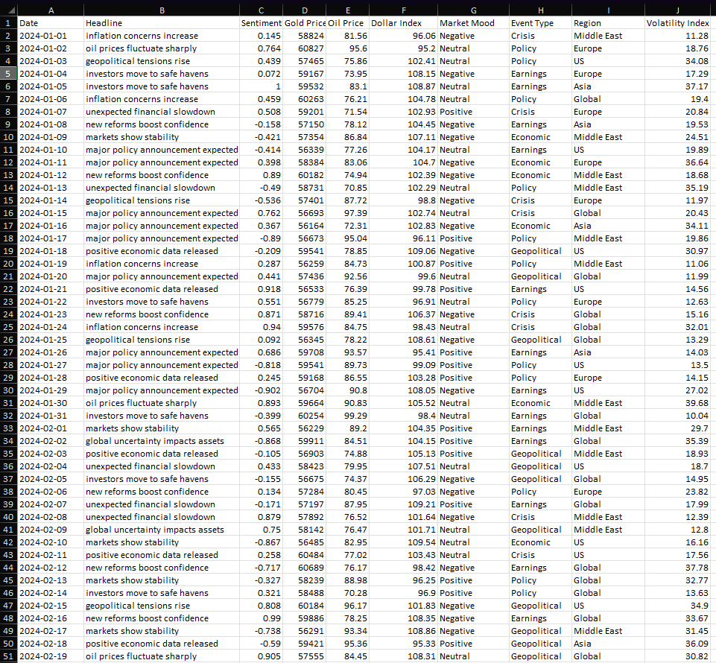
Dataset Overview
50 Rows × 10 Columns
Columns: Date, Headline, Sentiment Score, Gold Price, Oil
Price,Dollar Index, Market Mood, Event Type, Region, VIX
Sentiment calculated using VADER
Cleaned and aligned for analysis

Slide 14
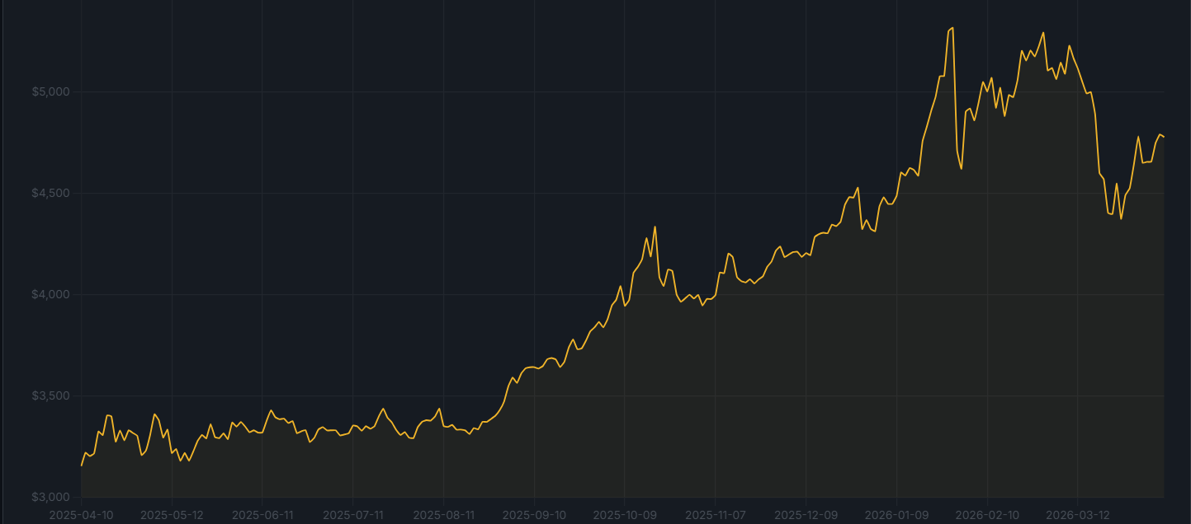
Gold Trend Visualization
Multi-year rising trend visible
Clear spikes during negative sentiment events
Graph validates correlation between sentiment and gold movement

Slide 15
Methodology
Phase 1:Collect news + commodity data
Phase 4: Data visualization
Phase 5: Correlation analysis
Phase 6: Model preparation
Phase 2:Sentiment scoring
Phase 3: Align sentiment with price indicators

Slide 16
Objectives
Study global events and gold prices.
Build dataset combining news sentiment and price data.
Test AI tools like NLP, LSTM, Prophet.
Prepare groundwork for predictive AI system.

Slide 17
Expected Outcomes
Sentiment-linked dataset
Clear visual trends
Correlation insights
Foundation for AI forecasting
Expandable into real-time system

Slide 18
Conclusion
Project successfully links sentiment with gold movement
AI helps simplify complex financial behavior
Future extension → real-time prediction

Slide 19
References
ACET (2024). Analysing Market Sentiment for Gold Commodity News Through NLP Techniques.
Gong, W. (2024). Research on Gold Price Forecasting Based on LSTM and Linear Regression. SHS Web of Conferences, Vol. 181.
Pflaumer, P. (2024). Gold Price Dynamics: Geometric Random Walk and ARIMAX Models. TU Dortmund University.

Slide 20
Thank You
Thank You
Questions & Discussion
Aurum Analytics

